Slide 1
How To Build TexGen

Slide 2

Contents
Introduction
Source Code
Prerequisites
Using Cmake
Building the TexGen Core
Building the Libraries – Python
Building the Libraries – VTK
Building the Libraries – wxWidgets
Building the Libraries – Open Cascade
The final build
Troubleshooting
Where to find help

Slide 3

Introduction

Slide 4
Introduction
TexGen is a geometry modelling pre-processor software written at the University of Nottingham. It can be used for modelling textile mechanics, permeability and composite mechanical behaviour. Based on modelling theory as set out in [1,2].
It is written in C++ with the functions accessible via a Python interface. It can be built on both Windows and Linux. If you do not wish to build the software, there are binaries available on either the releases section of the TexGen repo on Github:
https://github.com/louisepb/TexGen/releases
or on Sourceforge:
.
https://sourceforge.net/projects/texgen/files/texgen/
TexGen can be built in both debug and release modes. Debug mode enables use of the debugger which can be helpful when developing code. Debug builds of Python, VTK and wxWidgets are necessary if you want to build in this mode.
[1] M Sherburn, “Geometric and Mechanical Modelling of Textiles”, PhD Thesis (2007)
[2] L P Brown and A C Long. "Modelling the geometry of textile reinforcements for composites: TexGen", Chapter 8 in "Composite reinforcements for optimum performance (Second Edition)", ed. P Boisse, Woodhead Publishing Ltd, 2021, ISBN: 978-0-12-819005-0. https://doi.org/10.1016/B978-0-12-819005-0.00008-3

Slide 5

Source Code
TexGen is an open source geometry modelling pre-processor software written at the University of Nottingham. It is distributed under a GPL licence.
The source code is hosted on Github: https://github.com/louisepb/TexGen
Git can be downloaded online at https://git-scm.com/downloads
Set up an account on Github if you don’t already have one. With an account you can clone a copy of TexGen and create pull requests and raise issues to be fixed.
Clone/Download the repository to a folder on your computer.
Link to software
Action item

Slide 6
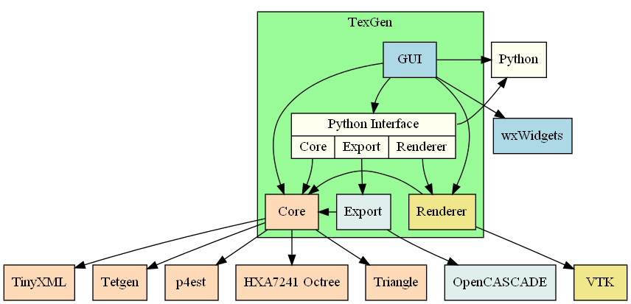
TexGen Code Structure
TexGen modules and how they interact with the external dependencies. For a working user interface the build requires Python for the scripting interface, wxWidgets for the user interface and VTK for the rendering.
Notes:
1. Diagram showing the TexGen modules and how they interact with the external dependencies. To get a working user interface build requires Python for the scripting interface, wxWidgets for the user interface and VTK for the rendering.

Slide 7
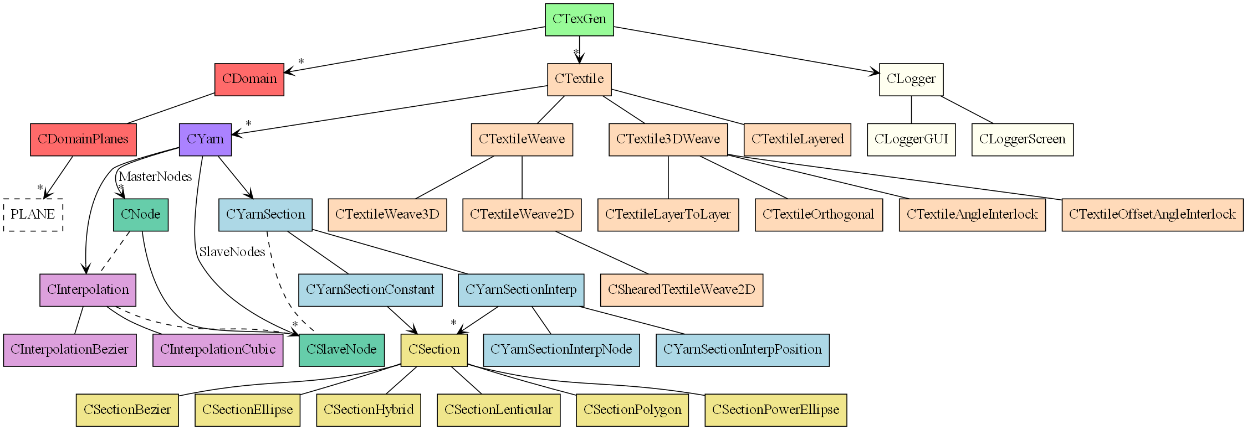
Core Class Hierarchy
Notes:
1. Class hierarchy diagram of the core functionality of the TexGen library.

Slide 8
Building TexGen
Windows

Slide 9
Prerequisites
To build TexGen and its dependencies on Windows requires MS Visual Studio. This provides both an IDE and the C++ compilers. The current build was completed using VS 2017. Make sure to check the option to install the Windows SDK.
Visual Studio 2017 can be obtained online with a free account. The install can take some time.
Cmake is used to configure the build environment, selecting 'Add CMake to the system PATH for all users' (select current user if this is not permissible on your system). https://cmake.org/download/
SWIG is used to wrap the C++ functions and make them available from the Python interface https://www.swig.org/
Download all the prerequisite software

Slide 10
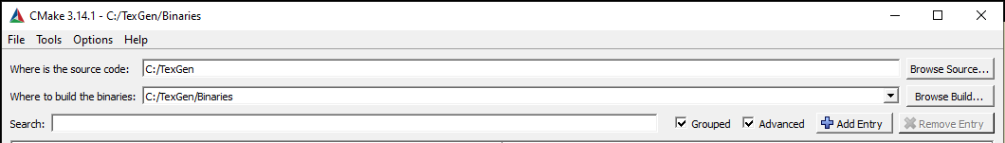
The Initial Build
To start we will complete a build of the TexGen Core library to check everything is working before adding the external libraries to complete the build later.
Open Cmake. Select the TexGen source code folder and choose a folder to place the binaries in, usually C:/<TexGen Folder Location>/TexGen/Binaries

Slide 11
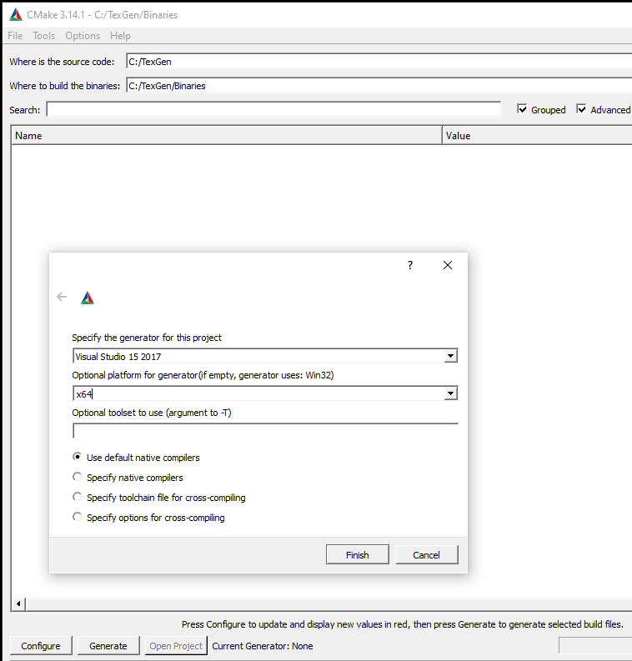
The Initial Build
To start we will complete a build of the TexGen Core library to check everything is working before adding the external libraries to complete the build later.
Press the ”Configure” button and choose the version of Visual Studio you have installed and select x64 if you have a 64 bit register computer.
You will probably get some errors.

Slide 12
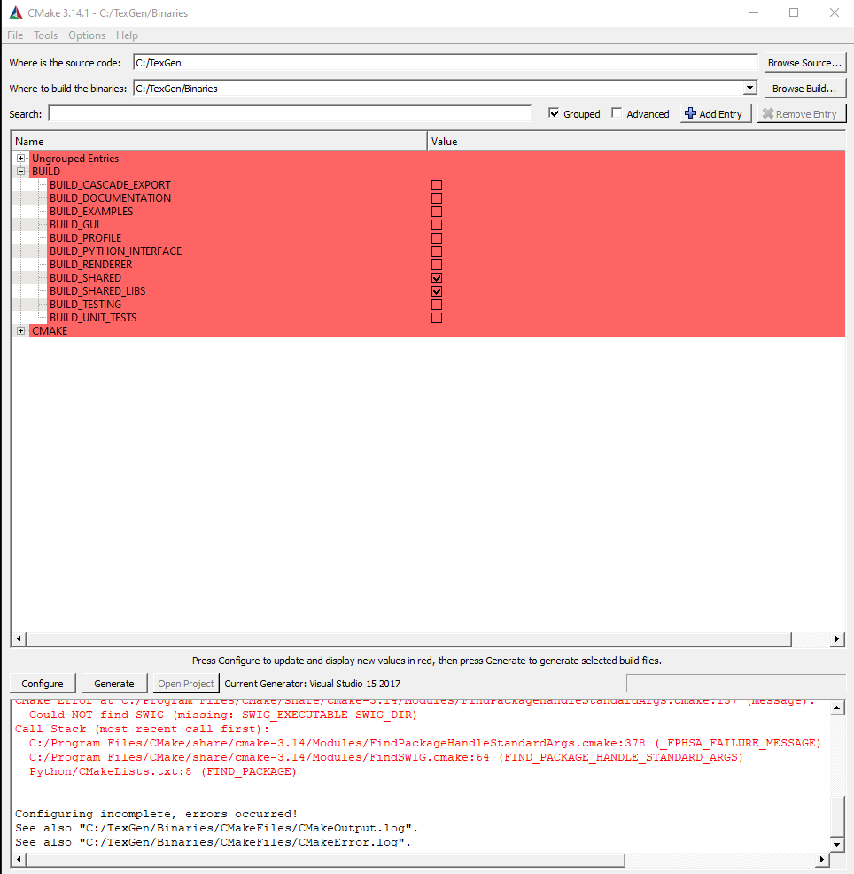
The Initial Build
To resolve the errors, change the Cmake variables so that only “BUILD_SHARED” is on.
This stops Cmake from looking for the external libraries required for the user interface. We’ll get to that later.
Press ”Configure” again. The build errors should now be resolved.
Press ”Generate” to generate the Visual Studio solution files.
”Open Project” to open the solution in Visual Studio

Slide 13
The Initial Build
To install the software you may need to open visual studio in “Administrator mode”. You can right click on the Visual Studio icon and select run in administrator mode.
In Visual Studio, check that the project files have been configured to build in Release mode and that the platform toolset is correct for your machine.
Check that Release mode and x64 platform are selected.

Slide 14
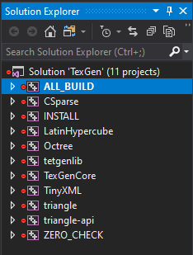
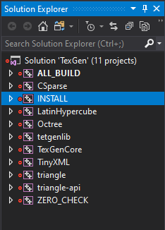
The Initial Build
In the solution explorer, right click on ”All Build” and in the menu click “Build”, this will compile the TexGen source code.
If you get a “Set local” error, it’s probably because you are not in administrator mode.

Slide 15
Building the Libraries
Windows

Slide 16
Python
The new release of TexGen is built with Python 3 and has been tested with version 3.9. To build the release version of TexGen download Python 3 from here: https://www.python.org/downloads/ then skip to to the “Adding Python to the Path” section.
If you want to build TexGen in debug mode and enable debug checks, you’ll need to compile a debug version of Python 3 from source code. Follow the instructions in the next few slides.
The Python source code is hosted on GitHub here: https://github.com/python/cpython/tree/3.9

Slide 17
Compiling Python
Clone the CPython source code: https://github.com/python/cpython/tree/3.11
Open a terminal: run cmd.exe
Go the Python directory
To download source code of dependencies (OpenSSL, Tk, etc.): type PCbuild\get_externals.bat
Type: PCbuild\build.bat -e -d -p x64
-e: download external dependencies (OpenSSL, Tkinter, …)
-d: build in debug mode (Py_DEBUG, enable assertions, …)
-p x64: build in 64-bit mode
Once the compilation process has completed, run the command “PCbuild\python_d.exe” if Python interpreter opens the process has succeeded.
The python39.dll or python39_d.dll created should be copied into the Release or Debug folder in which the TexGenGUI.exe file will be created.

Slide 18
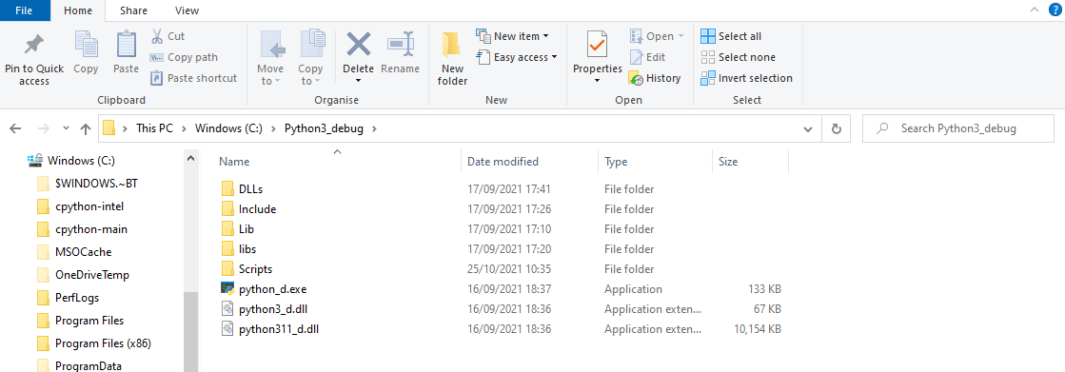
Python – Setting up the Directory
It’s best to set up a separate Python folder to put the newly built .dll, .lib and .exe files in. Run the following commands to do so:
xcopy C:\cpython\PCBuild\amd64\python_d.exe \Python3_debug\.
xcopy /I C:\cpython\PCbuild\amd64\*.pyd \Python3_debug\DLLs\
xcopy /I C:\cpython\PCBuild\amd64\*.dll \Python3_debug\DLLs\
xcopy C:\cpython\PCbuild\amd64\python3_d.dll \Python3_debug\
xcopy /V /S /E /H /I C:\cpython\Lib \Python3_debug\Lib\.
The Python directory should look something like this.
You may need to manually copy over the Include folder from the source directory.

Slide 19
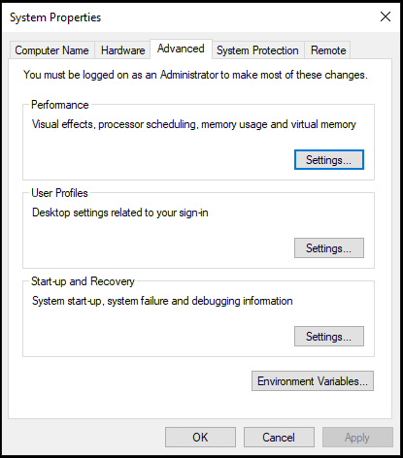
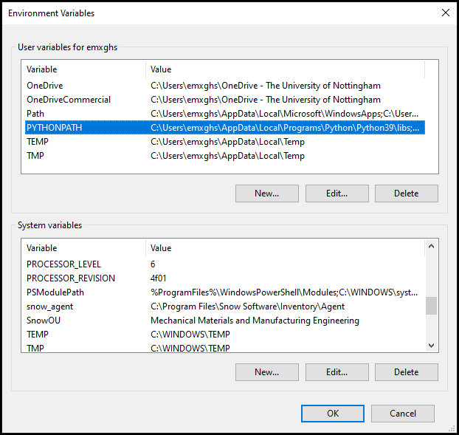
Python – Adding Python to path
To be able to access the Python interpreter from the command line, add Python to the system path by searching for environment variables from the start menu. Add an additional user variable called PYTHONPATH by selecting New..

Slide 20
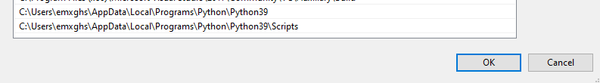
Python – Adding Python to path
Add the Python interpreter onto the system path by changing the system PATH environment variable to point to the new Python folder. If you compiled Python as in the previous slides it will be C:\Python3_debug and C:\Python3_debug\Scripts etc.
If you are using TexGen in release mode having downloaded Python, it will be something like C:\users\<username>\AppData\Local\Programs\Python39\ and
C:\ users\<username>\AppData\Local\Programs\Python39\Scripts

Slide 21
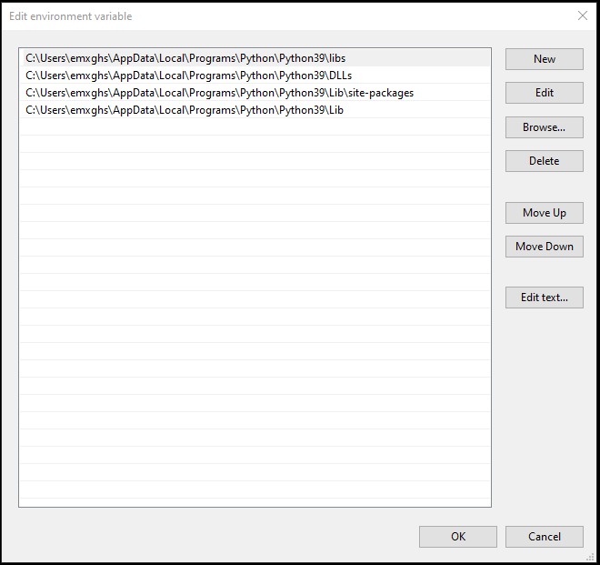
Python – Adding PYTHONPATH variables
Add the Python library files onto the PYTHONPATH by changing the PYTHONPATH environment variable to point to the new Python folder, if you compiled Python as in the previous slides it will be C:\Python3_debug and C:\Python3_debug\Scripts etc.

Slide 22
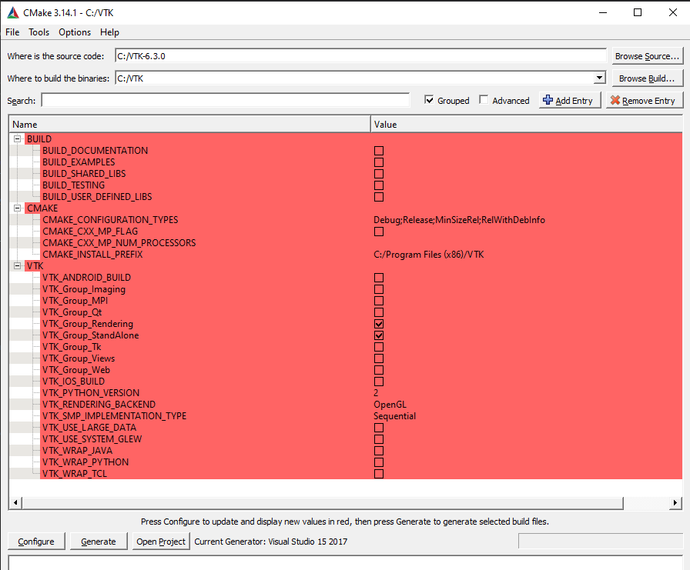
VTK
VTK is used to render the TexGen models in the user interface. This version uses VTK-6.3 and can be found here: https://github.com/louisepb/VTK-6.3 (This version is no longer available on the VTK download page and is saved here until TexGen is updated to use a more recent version). Download the files and extract them.
Run CMake again, click “Configure” and then make sure the following options are set.
Once completed, open Visual Studio and like before go to “All Build” and right click before selecting “Build”.

Slide 23
wxWidgets
Download and install the windows version 3.0.4 of wxWidgets (wxMSW). https://www.wxwidgets.org/downloads/
It is then necessary to compile wxWidgets from source. Detailed instructions on how to do this can be found in 'install.txt' located in the 'docs\msw' subfolder. The main steps are to open 'wx.dsw' with MSVC located in the 'build\msw' subfolder and compile both Release and Debug configurations (The configuration can be selected from the drop-down box on the main toolbar in Visual Studio. Universal and DLL versions need not be compiled).

Slide 24
The final build
Windows

Slide 25
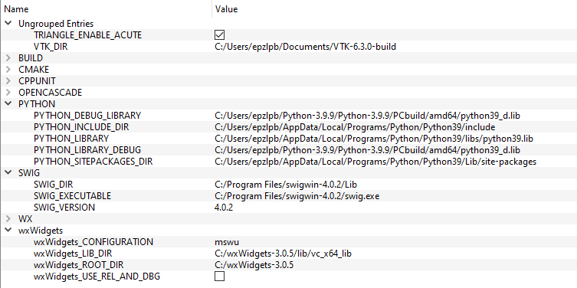
Configuring optional modules
Once the additional libraries have been built, they can be used to build the renderer, Python interface and GUI.
Reopen Cmake, selecting the TexGen folders used in the first section. Select the additional modules you want to include. To build the renderer, Python interface and GUI select the renderer, GUI and Python in Cmake and enter the paths for the libraries as shown below (with the correct paths for your installations).
Change wxWidgets_CONFIGURATION to mswud for debug builds

Slide 26
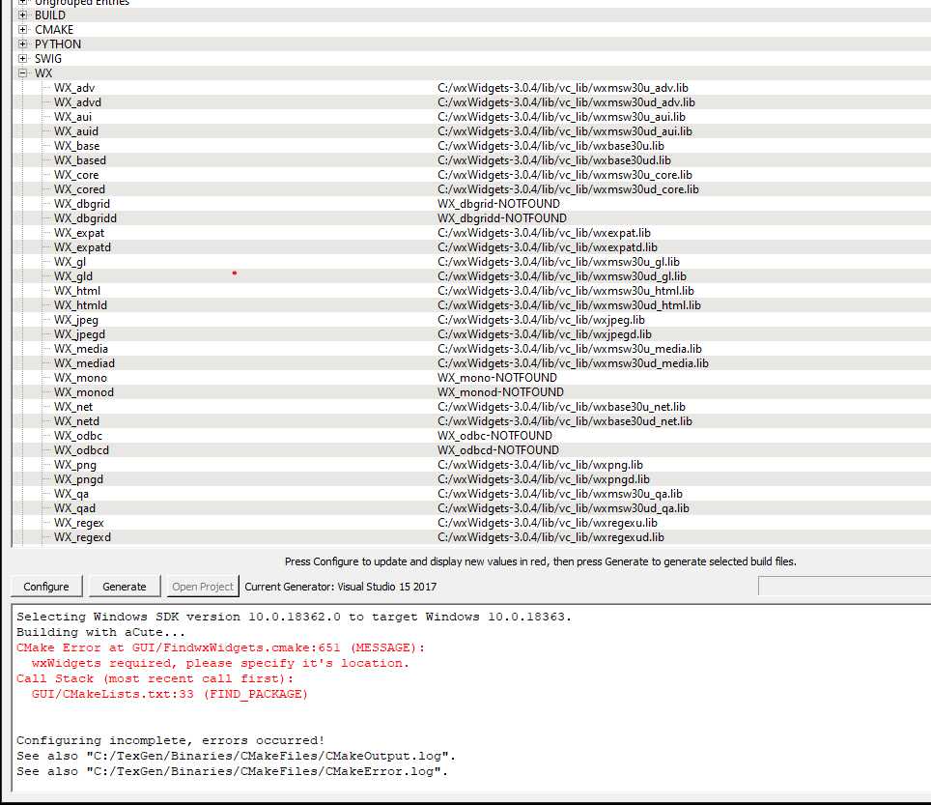
Configuring optional modules
After pressing configure, you will may some errors as Cmake struggles to find the wxWidget libraries. You will have to put them in individually as below (note that not all entries are shown in the screenshot).

Slide 27
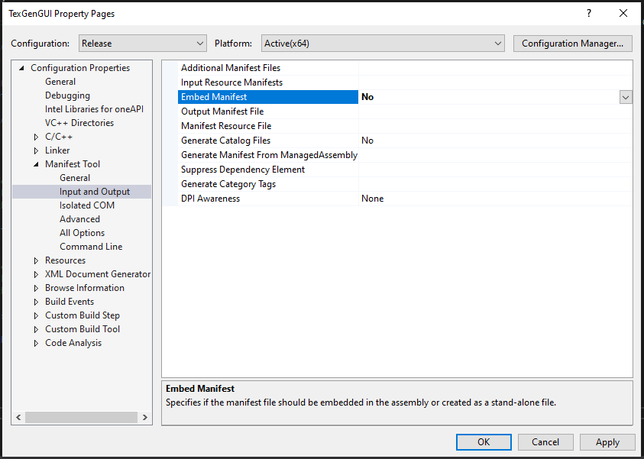

Finishing the Build
To make a full build of the software, once the additional libraries have been built these can be used to build the renderer, python interface and GUI.
Press Configure again, hopefully CMake will finish configuring correctly.
After pressing Generate, if Visual Studio is already open it will prompt you to reload some of the projects from disk. Select Reload All. Otherwise select “Open Project” from Cmake to open Visual Studio.
You will need to change the Embed Manifest value to ”No” by going to Properties-> Manifest-> Input and Output. Then click OK to accept the change.
Check that the project is set to “Build” or “Release” as
appropriate (as shown on Slide 13).
As before, right click All Build and click Build. Repeat for
the “Install” project.

